Slide 1
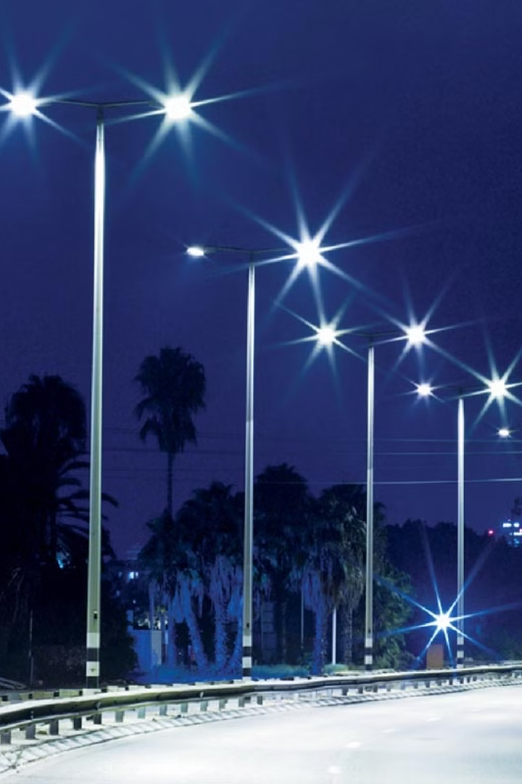
Introduction to the Smart Street Light Project
The smart street light project aims to revolutionize public lighting by implementing motion-sensing technology. This innovative approach will significantly reduce electricity consumption and contribute to environmental sustainability.
By-Harsh Bhardwaj, Vansh latiyan , Sumit verma
MD.Farhan Akhtar , Sachin kumar.

Slide 2
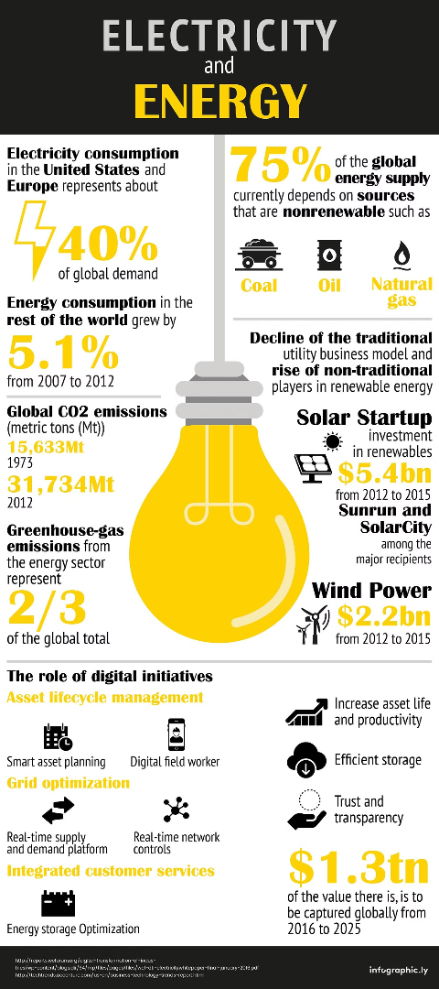
Problem Statement: Excessive Electricity Consumption
1
Costly
2
Inefficient
Traditional street lights consume a significant amount of electricity, leading to high operational costs for municipalities.
Continuous illumination during low-traffic periods wastes energy and contributes to unnecessary light pollution.
3
Environmental Impact
The excessive electricity consumption of street lights contributes to carbon emissions and environmental degradation.

Slide 3
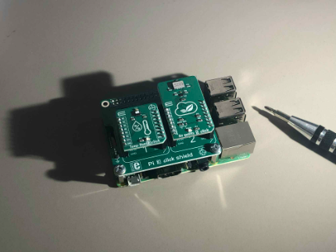
Solution: Motion-Sensing Technology
Motion Detection
Advanced motion sensors will activate street lights only when motion is detected, optimizing energy usage.
Smart Technology
The implementation of smart technology will enable precise control and efficient operation of street lights.
Sustainable Approach
The use of motion-sensing technology aligns with sustainable practices by minimizing energy wastage.

Slide 4
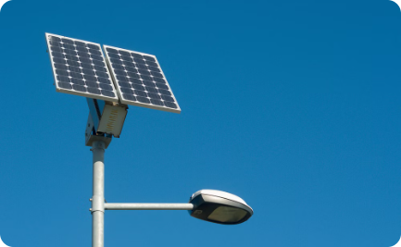


Solar Panel Street Light
Renewable Energy
Efficiency & Sustainability
Cost-Effectiveness
The integration of solar panels allows street lights to operate with renewable solar energy, reducing dependency on the grid.
They offer cost savings in the long run by harnessing free and abundant solar energy for street lighting.
Solar-powered street lights contribute to sustainable infrastructure and reduce the environmental impact of energy production.

Slide 5
Benefits of the Smart Street Light Project
80%
10K
40%
Energy Savings
Annual Cost Savings
Environmental Impact
The implementation of motion-sensing technology can result in an 80% reduction in energy consumption.
The project could lead to cost savings of over $10,000 annually for each street light installation.
A reduction of 40% in carbon emissions is expected due to the efficient use of electricity.

Slide 6
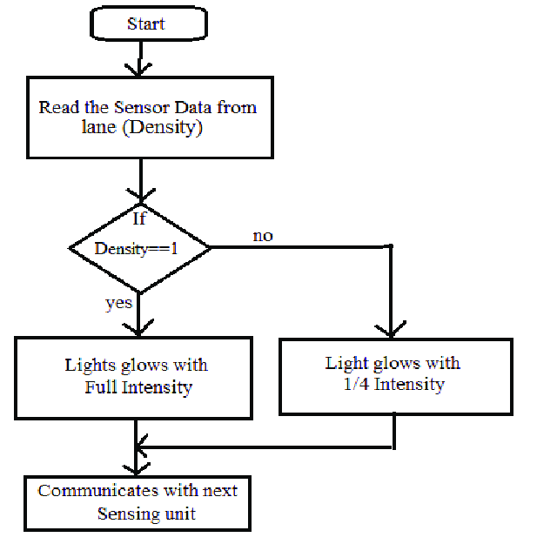
Flow Chart

Slide 7
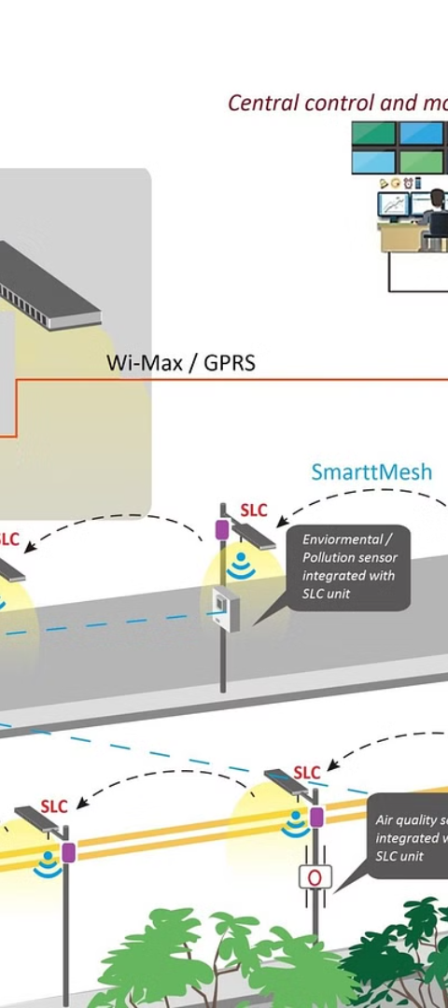
Implementation Plan and Timeline
1
Phase 1: Pilot Installation
Initial testing and installation of motion-sensing street lights in select urban areas.
2
Phase 2: Expansion
Gradual expansion of the project to cover a wider network of street lights across the city.
3
Phase 3: Full Implementation
Complete integration of motion-sensing technology in all street lights to ensure maximum energy efficiency.

Slide 8




Potential Challenges and Mitigation Strategies
Technology Reliability
Ensuring the consistent and reliable performance of motion sensors in varying weather conditions.
Community Acceptance
Educating and gaining community support for the transition to motion-sensing street lights.
Regulatory Compliance
Adhering to municipal regulations and standards to implement the new technology seamlessly.

Slide 9
Cost Analysis and Return on Investment
Initial Investment
Return on Investment
Long-Term Savings
The cost of installing the new technology will be offset by long-term energy savings and reduced maintenance expenses.
Anticipated return on investment is expected within 3 years after the implementation of the smart street light project.
Significant reduction in operational costs and potential for additional revenue generation from excess energy production.

Slide 10

Conclusion and Next Steps
Environmental Conservation
Community Well-Being
Future Expansion
Potential for future integration of smart technologies for enhanced city infrastructure and services.
The initiative aligns with the city's commitment to sustainability and environmental stewardship.
The project aims to enhance community safety and well-being by providing well-lit public spaces.

